Slide 1
INTRODUCTION TO PYTHON PROGRAMMING CSE18R254 MINI PROJECT ILLEGAL KIDNAPS IN INDIA GUIDE-MR:R.RAJA SUBRAMANIAN SIR

Slide 2
ILLEGAL KIDNAPS IN INDIA
CONTENTS:
Introduction
Year wise analysis of cases reported.
Male versus female ratio.
State wise distribution of the numbers(kidnap cases).
Motivation for kidnap.
Analysis on the age numbers of the victims.
CONCLUSION.
PYTHON SEMESTER PROJECT:
A presentation by:
Shiridi :9919004202
Yeshwanth :9919004146
Nitesh :9919004154
Yugendher :9919004027
Ranjith :991004014
Akash :9919004008

Slide 3
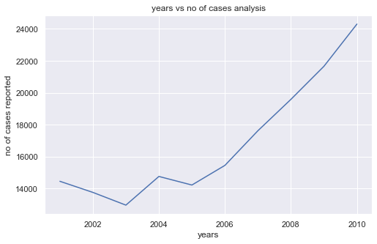
INTRODUCTION
It has been years and decades as the crime called “kidnap” had started .The trend of the numbers of these crimes are increasing as well as the victims ,especially in India .This growing numbers are creating fears in minds of the citizens of the country.
Year wise analysis of kidnap cases reported in India:
The given graph shows the trend of
the Kidnap cases reported in
India from the year from the year
2001 to 2010 .
We can basically see the increasing
trend in the graph .Almost 24000
Kidnap cases have been reported in
the year 2010,which is the highest
According to the given records from the year 2001 to 2010.

Slide 4
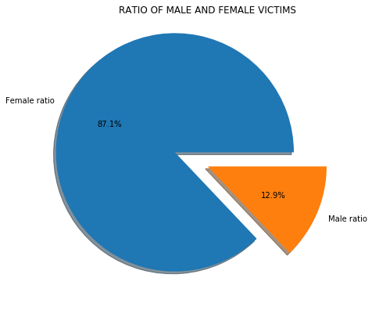
Male Vs Female Ratio
The given pie chart depicts
the male and female ratio of
the number of victims of
kidnaps.
And we can analyze it
and can unanimously say
that it is the women mostly
the victims of the Kidnaps.
The female ratio(87.1%) is
Almost seven times the male
Ratio(12.9%).

Slide 5
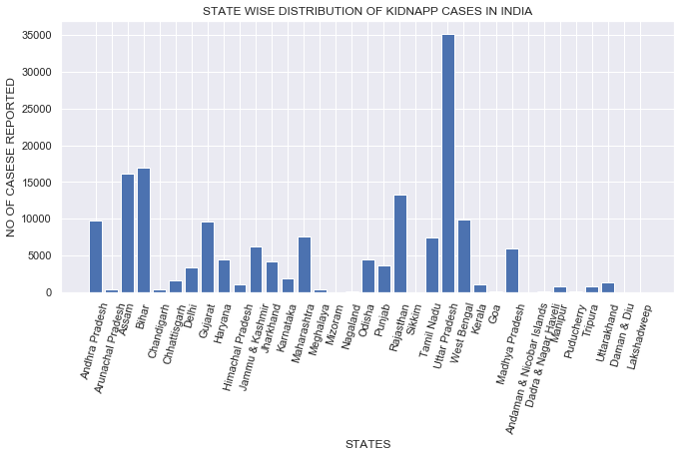
State wise analysis on the number of kidnap cases in India:
Here is the analysis of different
states and the number of the number
of cases reported in the state.
We can analyze that Uttar Pradesh
is leading in this crime , and almost
35000 cases have been reported alone
from Uttar Pradesh from the year 2001
to 2010.
Union territories like Andaman and
Nicobar Islands , Lakshadweep have
reported a fascinating zero number.

Slide 6
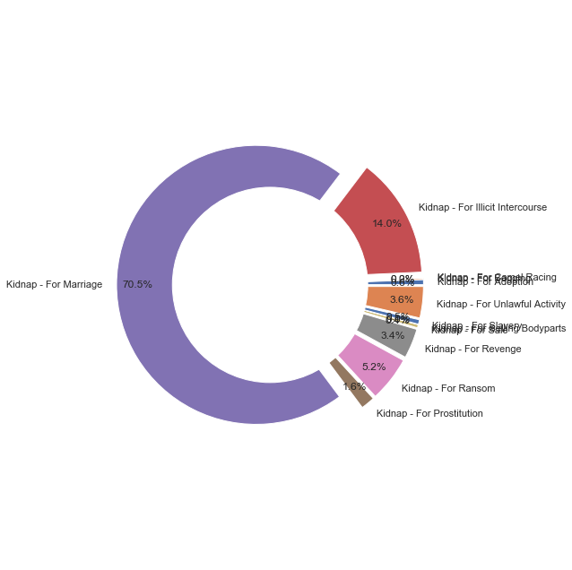
Motivation for kidnaps
The given pie chart (doughnout)
depicts the analysis of the
Motivation or purpose of kidnaps.
We can analyze that nearly 70.5%
of kidnaps are for the purpose of
Marriage and also some other
purposes like women Prostitution ,
kidnap for Revenge and kidnap for
Illicit Course also share the major
Ratio in the overall kidnap cases.

Slide 7
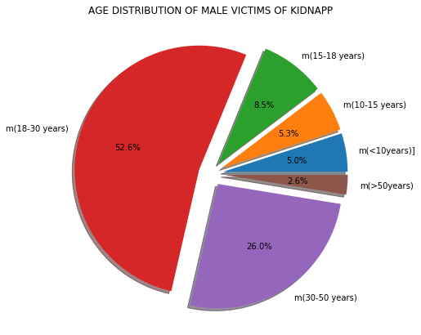
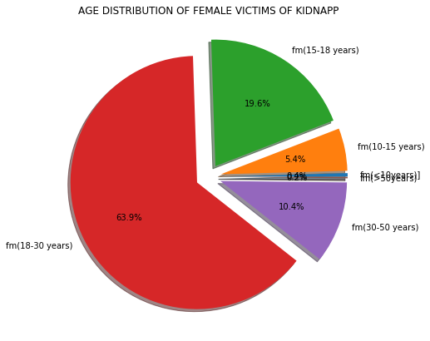
Analysis on the age numbers of the victims.
The given pie chart shows the analysis on the age of male victims of the kidnaps. We can generally see that the men of age group between the age of 18 and 30 years are been mostly the victims (approximately 50% of the total victims).
The given pie chart shows the analysis on the age of female victims of the kidnaps. We can generally see that the women of age group between the age of 18 and 30 years are been mostly the victims .(approximately 63% of the total victims).

